Slide 1
Blockchain
ICT Platform for learning and inclusión
Mauro Rivadeneira
Ecuador

Slide 2
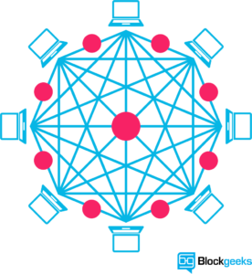
What is a Blockchain?
We could define Blockchain as a distributed database which has many nodes interacting each other in order to keep the information updated and secure.
It can execute transacctions between two parts without the need for an intermediary

Slide 3
No intermediaries
For example if Person A wants to transfer money to Person B.
In the classic model Person A execute the transaction and it is reviewed by a financial entity which is the in charge to complete the transaction and transfer the money to Person B account (Dependent).
In Blockchain model, it is simple. Person 1 execute the transaction and it is directly transferred to Person B account, and the other members of the network can talk in order to validate the transaction (Independent).

Slide 4
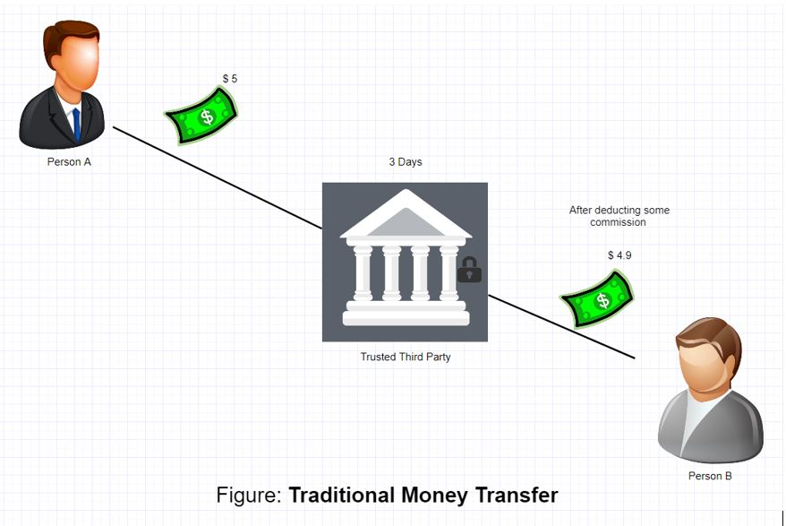
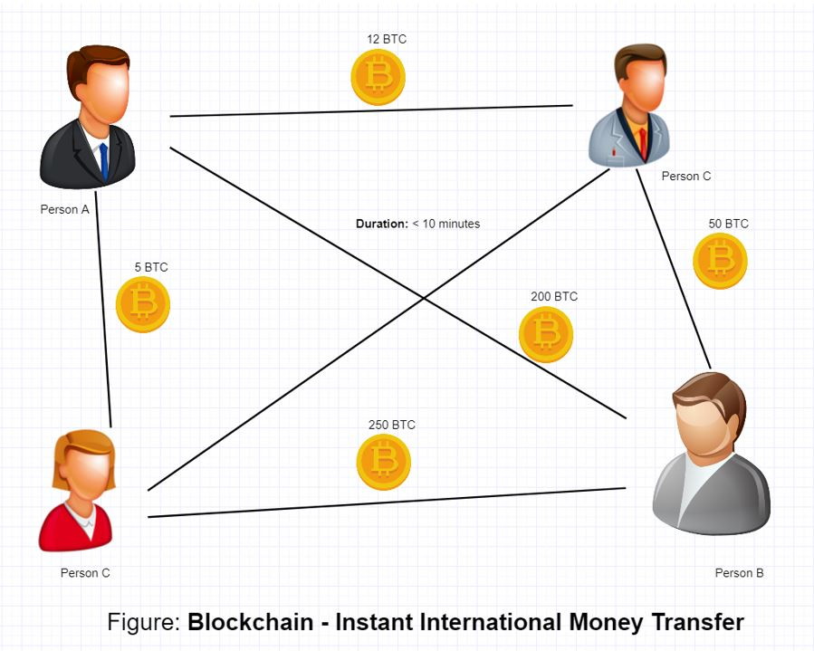
Classic model | Blockchain model

Slide 5

Not only for financial apps
Blockchain is popular because is the basis for electronic currencies, but its capabilities go beyond, it can be used for systems that needs to be safe, transparent and unalterable.
Important documents could be storing in the blockchain in order to take advantage of these characteristics and be easy to access.
For example electronic vote aplications, transfer of ownership or ownership, public purchases patents, medical records could be powered by Blockchain.

Slide 6
EXAMPLES
If one person wants to buy a car, the domain could be transfered to this person in the blockchain and mantain there, secure and unalterable.

Slide 7
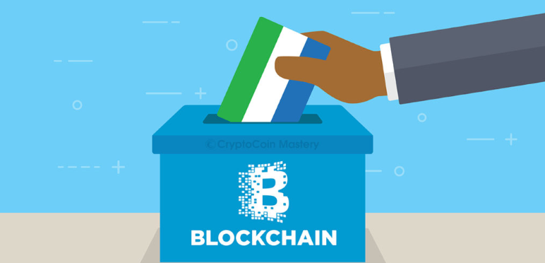
Examples
E-voting could be implemented to make an infrasctructure with an absolute valid vote and a transparent process of elections because noone has the ability to alter vote results.

Slide 8
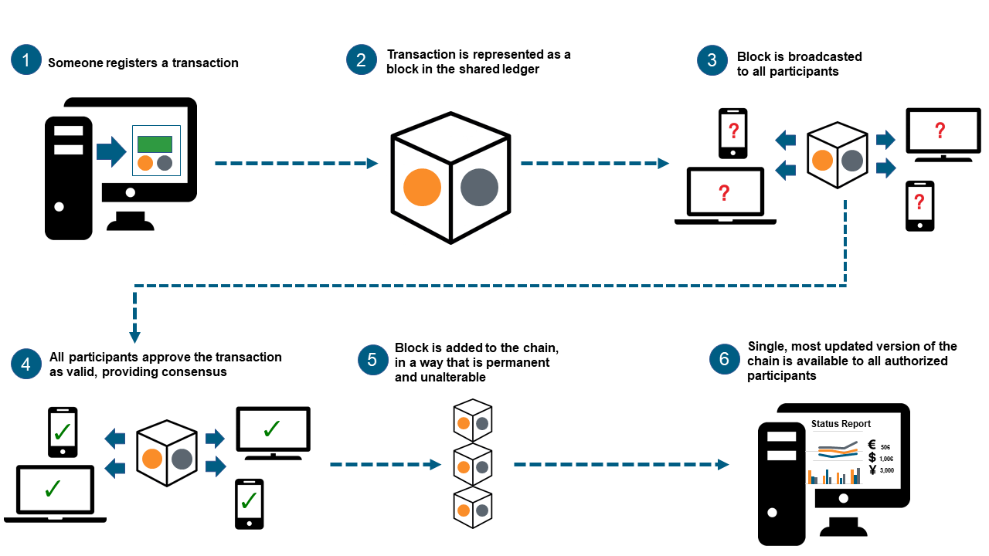
HOW DOES IT WORKS?

Slide 9
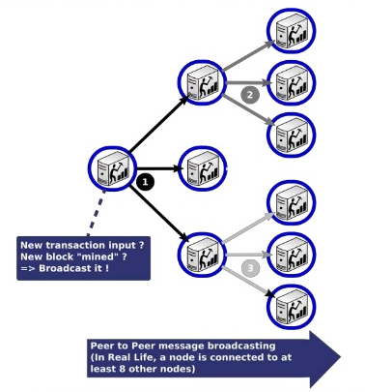
WHY IT’S SECURE
When a participant of the network realice a transaction, this transaction register is replicated to the other participants or “miners”.
These miners are responsible for verifying the validity of the transaction.

Slide 10
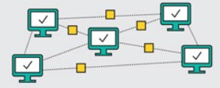
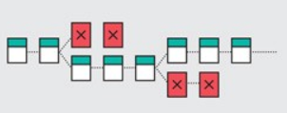
Concensus
When a block is validated for the miners, it is distributed through the network. Each one adds the block to the majority chain.
If a malicious miner tries to submit an altered block, the hash function of that block and all following blocks would change. The other nodes would detect the changes and reject the block from the majority chain, preventing corruptions.
Thats why the more participants the network has, the safer it will be.

Slide 11
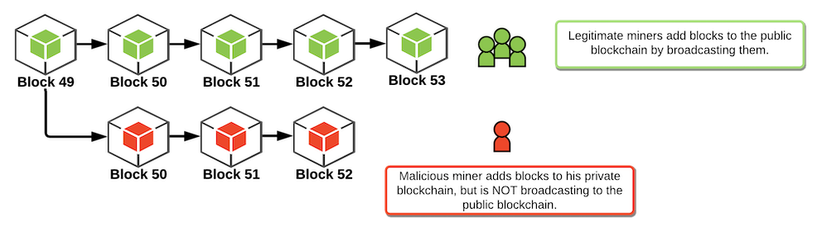
It means that the information which is valid for the 51% of the participants its consider the true information.
For example it could be easy to attack a network with ten nodes, because the attacker has to vulnerate six to control the blocks data, but it results impossible to attack a network with ten thousand nodes.

Slide 12

HASH
One of the most important concepts to understand Blockchain is Hash.
We could say that Hash consist in a method for anonimizing data which is widely used in criptography.
Basicaly the process is to make pass a text value through a mathematical function to obtain a hash value.
Hash Function
Hash Value

Slide 13
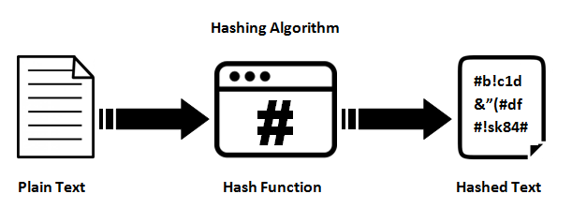
Hash
A hash has a fixed length, no matter how big the text is.
Each hash is unique for each text.
Any modification in the text will result in a completely different hash

Slide 14
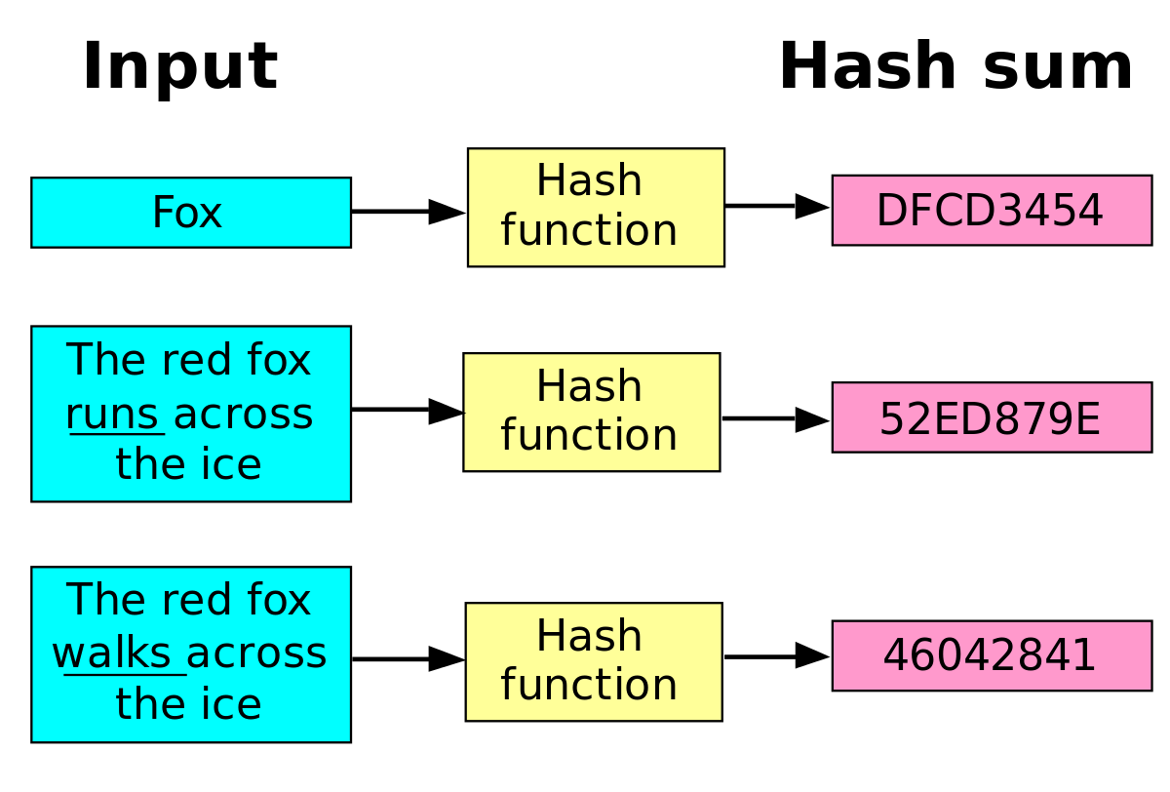
Hash
Suppose we have a text of 1 word, another of 7 words and we are going to use the SHA 256 algorithm.
Both the 1-word text and the 7-word text will have a 256-bit hash, but different.
Now suppose that the text of 7 words is only changed one letter, the resulting hash value does not look like the previous one

Slide 15
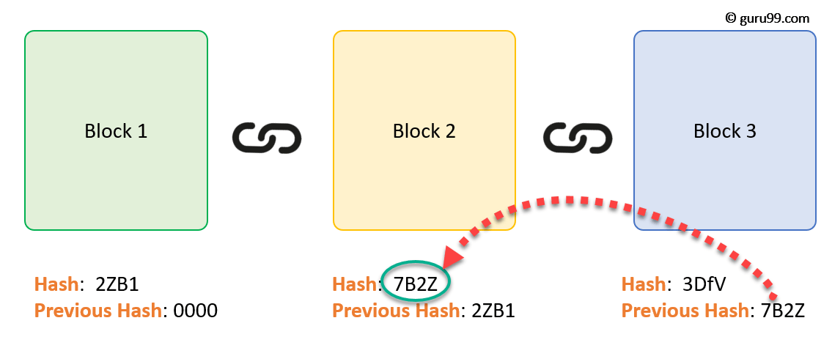
Blockchain uses Hash to connect blocks

Slide 16
Store data in the blockchain
As it has been said Blockchain is a distributed database, however its funality is that of providing integrity to the data, so in terms of storage has certain limitations.
Validating transactions currently requires a computational cost that rises the larger the transaction. so it is not efficient to store large amounts of data in a single block.
If personal information is stored, it will be available to all participants in the network.
Blockchain lacks a query language like SQL from traditional databases, which makes it difficult to extract specific data.
In other words, the amount of data that can be stored is quite limited

Slide 17
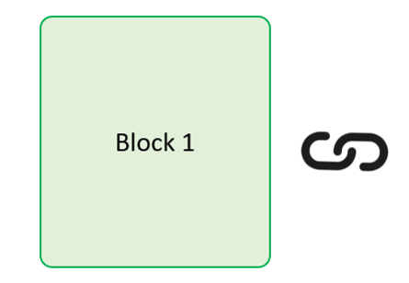
THE COST OF STORING DATA IN BLOKCHAIN
In order to solve the previous problem, we are going to use hash funtions again.
Hash is used to identify the members of the chain (block hash), but if we add another hash value to the block which represents our data (iformation hash) it would be very efficient.
The only thing we store in the block chain is the hash of our data. In comparison with our data, the hash is very small, so the cost of a transaction would be relatively low.
Block Hash: S7D6
Previous Block Hash: OPL8
Information Hash: G2Z1

Slide 18
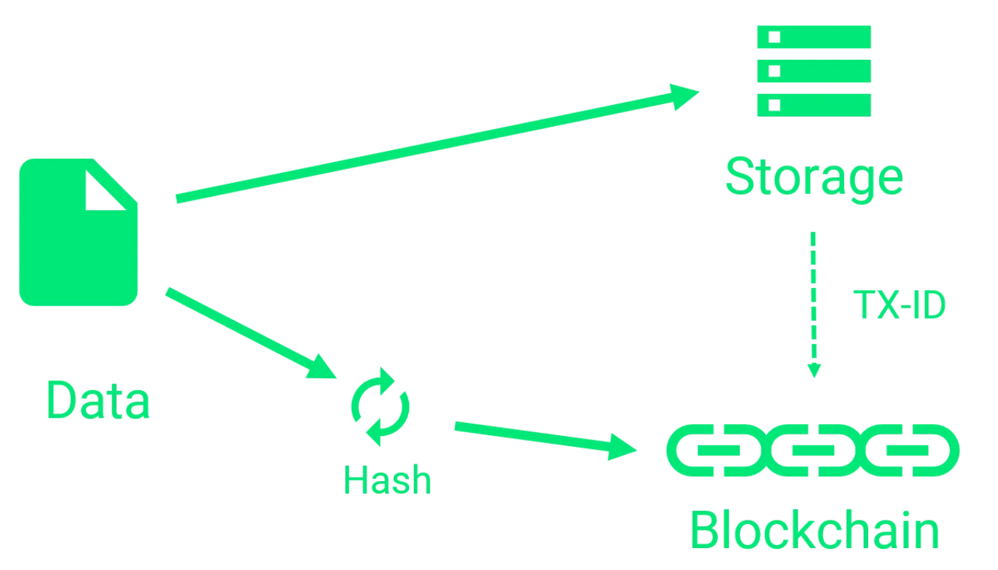
PURPOSED MODEL FOR LITA

Slide 19
HASH FOR CERTIFICATES
The proposed model is to build a blockchain that stores only the hash value of the certificate, which is found in the database of the platform.
The validation process consists of obtaining the hash value of the document stored in the platform and comparing it with the hash value stored in the blockchain. Once these are equal, the certificate will be accepted as valid and the information will be sent to the user through the web application.

Slide 20
INTEREST LINKS
https://www.xataka.com/especiales/que-es-blockchain-la-explicacion-definitiva-para-la-tecnologia-mas-de-moda
https://social-blockchain.org/2018/11/16/almacenamiento-de-datos-en-la-blockchain/
https://academy.bit2me.com/como-funciona-el-hash-en-bitcoin/
https://www.fin-tech.es/2016/10/aplicaciones-de-la-tecnologia-blockchain.html
https://bitcoin.es/criptomonedas/que-es-un-ataque-de-51-de-la-blockchain/
https://medium.com/ignation/pulling-the-blockchain-apart-the-transaction-life-cycle-7a1465d75fa3

